Slide 1
Burrito Dataset Statistical Analysis
Ninjaz

Slide 2
Introduction

Slide 3
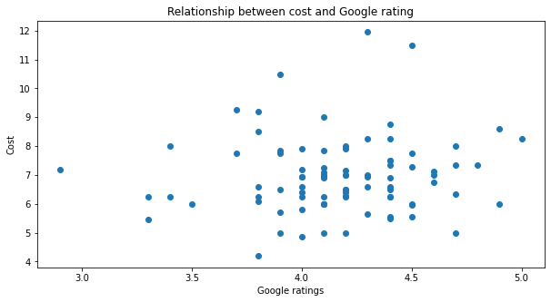
Relationship between cost and google rating
When the meal cost is low, Google's rating is distributed in the range of 4 to 4.5 out of 5.

Slide 4
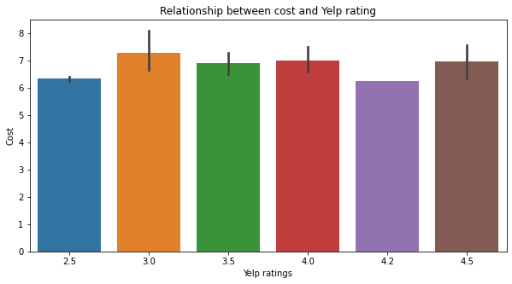
Relationship between cost and Yelp rating
From this chart there is no clear relationship between cost and rating so we can see that the price of the burrito has no impact on how good the burrito tastes.

Slide 5
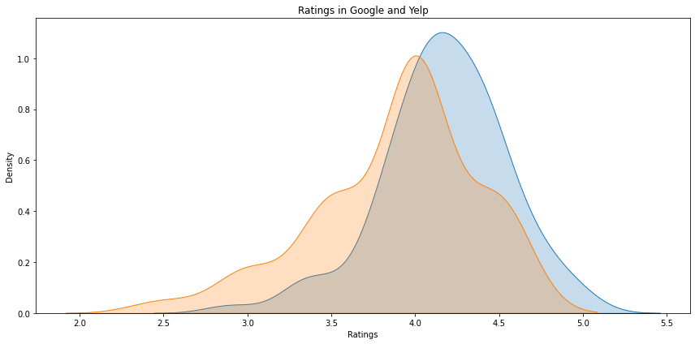
Rating in Google and Yelp
The results are showing that the density of ratings on Google is higher than what is on Yelp.

Slide 6
Conclusion

Slide 7
Reference
01
https://www.scoremyreviews.com/google-reviews-vs-yelp-which-one-matters-the-most/
Shea, K., 2022. Yelp vs. Google Reviews: 7 reasons why google reviews are better for your business. Home Service Direct. Available at: https://www.homeservicedirect.net/yelp-vs-google-reviews-7-reasons-why-google-reviews-are-better-for-your-business/ [Accessed September 28, 2022].
Admin, 2021. Google Reviews vs. yelp - which one matters the most? Score My Reviews. Available at: https://www.scoremyreviews.com/google-reviews-vs-yelp-which-one-matters-the-most/ [Accessed September 28, 2022].
02

